Slide 1
Universal Studio Singapore
Reg No_20_Zhang Zi Qian _1N3

Slide 2
Zones
Lost World
New York
Holly wood

Slide 3
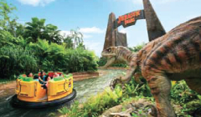
Lost World
Divided into two themed areas: Jurassic Park™ and WaterWorld™, this zone is for fans of the two blockbuster movies, as they can experience a dense tropical forest where dinosaurs lurk, then watch death defying stunts filled with thrills and spills!

Slide 4
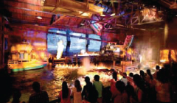
New York
Feel the spirit and energy of America's biggest and grandest city as you stroll along the sidewalks and enjoy all the classic landmarks. Soak in the impressive city skylines, neon lights, and facades that set the scenes for big city fun and real-time movie production.

Slide 5
Holly Wood
Step onto Hollywood Boulevard framed by dynamic architecture, palm trees and the famous
Walk of Fame, you will feel as if you have landed in the center of the entertainment universe.

